Slide 1
Intelligent Predictive Maintenance for Smart Building Systems

Slide 2
agenda
Introduction
Objective
Dataset Information
Methodology
Models Used
Conclusion
Future Plans

Slide 3
Introduction
Intelligent Predictive Maintenance (IPM) is a method used in smart buildings to predict and prevent equipment failures, ensuring smooth and efficient operations.
IPM helps in early failure detection, reduces downtime, extends the life of equipment, and optimizes maintenance schedules, which lowers costs and improves building performance and comfort.
Implementing IPM faces challenges such as ensuring data quality, maintaining security and privacy, dealing with complex models, and making these models easy to understand.
Cutting-edge methods like machine learning, deep learning, and hybrid techniques are being developed to improve IPM. For example, federated learning helps detect anomalies while protecting privacy, addressing some of the key challenges in smart building maintenance.

Slide 4
Objectives
Early Fault Detection And Data Security : Investigate how Intelligent Predictive Maintenance (IPM) can identify abnormalities and problems in building systems at an early stage to enable prompt intervention and reduce the likelihood of catastrophic failures.
Reduced Downtime: Examine the effectiveness of IPM in lessening system downtime and minimizing disturbances to building operations and occupants by recognizing defects early.
Extended Equipment Lifespan: Explore the potential of IPM to extend the lifespan of building systems by identifying and fixing problems before they become severe, thereby reducing the need for premature replacements.
Optimized Maintenance Schedules: Assess how IPM can optimize maintenance schedules by anticipating when maintenance is needed, thus minimizing unnecessary or premature maintenance activities.
Data Quality Improvement: Address the challenges related to ensuring high-quality data to produce accurate forecasts and decisions, as low-quality data can diminish the efficacy of IPM.

Slide 5
Objectives
Model Complexity Management: Develop strategies to handle the complexity of IPM models, which require significant knowledge and processing power to create and maintain.
Model Interpretability Enhancement: Improve the interpretability of IPM models to make the logic behind their forecasts and decisions easier to understand.
Application of Advanced Techniques: Evaluate the use of cutting-edge methods such as machine learning, deep learning, statistical techniques, and hybrid methodologies in IPM to maximize advantages and address challenges.
Implementation of Federated Learning: Explore the potential of federated learning, a privacy-preserving machine learning technique, for anomaly detection and its effectiveness compared to centralized models in terms of response time and performance.

Slide 6
Dataset Information
Dataset Overview:
Location: UC Berkeley's Sutardja Dai Hall (SDH).
Content: Environmental sensor measurements including CO2 concentration, room air humidity, temperature, luminance, and passive infrared (PIR) motion sensor data.
Purpose: To examine the spatial characteristics of rooms and their environmental conditions.

Slide 7
Dataset Information
Sensor Measurements:
CO2 Concentration: Provides information on air quality and ventilation efficiency.
Room Air Humidity: Measures the moisture level in the air, important for comfort and health.
Temperature: Records the room temperature, crucial for thermal comfort and energy usage.
Luminance: Measures light levels, affecting both energy consumption and occupant comfort.
PIR Motion Sensor: Detects infrared light from objects, indicating the number of people in the room.

Slide 8
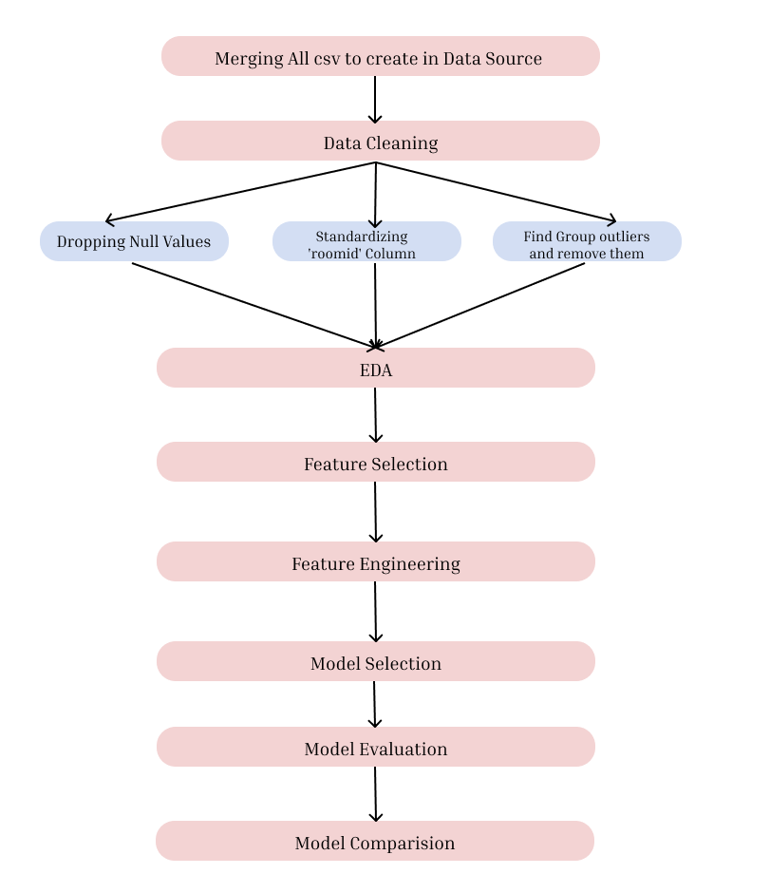
Methodology
Data preparation, including cleaning, transforming, and integrating data, is crucial for accuracy. This study used sensor data from 51 rooms in smart buildings, tracking variables like light, temperature, humidity, CO2, and PIR readings. Preprocessing involved removing null values. Exploratory Data Analysis (EDA) used statistics and visualization to understand data distribution. Feature engineering with StandardScaler and SelectKBest prepared data for modeling. Machine learning algorithms, including Decision Tree, Random Forest, and Linear Regression, were trained to predict temperature, with performance evaluated using MSE, MAE, and R-squared metrics.

Slide 9
Models used
Linear Regression: Predicts temperature using a simple linear relationship with features.
Decision Trees: Models complex, non-linear relationships without data distribution assumptions.
Random Forests: Uses multiple decision trees to enhance accuracy and reduce overfitting.
K-Nearest Neighbors (KNN): Predicts based on the k-nearest data points in the feature space.
Multilayer Perceptron (MLP): An ANN that captures complex non-linear interactions.
Gradient Boosting: Builds a strong model by iteratively combining weak models to minimize errors.
Ridge Regression: Enhances linear regression by adding a regularization term to prevent overfitting.

Slide 10
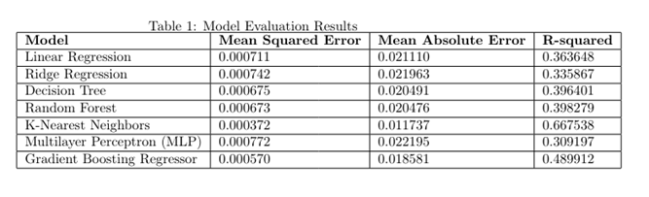
Results

Slide 11
Conclusion from results
The model comparison reveals varying performance across different algorithms for temperature prediction in smart building environments. While linear regression and ridge regression offer simplicity and moderate accuracy, decision trees and ensemble methods like random forests and gradient boosting demonstrate improved predictive power. Notably, K-nearest neighbors outperforms others with the lowest mean squared error and highest R-squared value, indicating its effectiveness in capturing complex data relationships. Considering the diverse data patterns and the need for robust predictions, a mixed-model approach incorporating various algorithms could enhance overall prediction accuracy and robustness, balancing interpretability with performance and mitigating overfitting while capturing domain-specific insights.

Slide 12
Future Plans
Mixed Models Approach:
Incorporating a mixed-model approach involves combining various machine learning algorithms such as linear regression, decision trees, ensemble methods like random forests and gradient boosting, and instance-based learning like K-nearest neighbors. This strategy ensures a comprehensive solution by leveraging the strengths of each algorithm, balancing interpretability, accuracy, and robustness for improved temperature prediction in smart building environments.
Expansion to Different Rooms:
Extending the temperature prediction model to different rooms within the smart building enhances its applicability and scalability. By incorporating sensor data from diverse locations, the model can capture variations in environmental conditions across the building, allowing for more tailored and accurate predictions. This expansion enables a broader scope of application, catering to the unique needs and dynamics of each room.

Slide 13
Future Plans
Suggestion Methodology:
Developing a suggestion methodology involves implementing a system for utilizing temperature predictions to inform building management decisions. This could include recommending adjustments to heating, cooling, or ventilation systems based on predicted temperature trends. By integrating predictive analytics with actionable insights, the suggestion methodology aims to optimize energy efficiency, occupant comfort, and overall building performance.
Website Implementation:
Creating a website interface for accessing and visualizing temperature predictions and related data offers a user-friendly platform for stakeholders to interact with the predictive model. The website could feature dashboards displaying real-time temperature forecasts, historical trends, and suggested actions for building management. Additionally, interactive tools and visualization techniques could facilitate data exploration and decision-making, enhancing the usability and accessibility of the temperature prediction system.

Slide 14
Thank you
Yashashree S Bedmutha
Yojana Naik

